Slide 1
Convolutional Neural Networks to Determine Breeds of Dogs by Using Tensorflow
Rachel (Zheran Wang)
Department of Statistics

Slide 2
Content
Introduction
Goal
Methods
Results
Conclusion

Slide 3
Introduction
Convolutional Neural Networks (CNN) is a class of artificial neural networks that mostly use on image analysis.
CNN has input layer, output layer and multiple hidden layers. The hidden layers usually refers to convolutional layer, pooling layer, and fully connected layers.

Slide 4
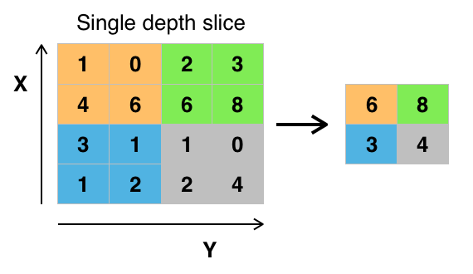
Introduction
Convolutional layer applies a operation to the input and pass down to next layer.
Pooling layer gather the outputs of clusters at one layer and put into a single neuron in the next layer.
ReLU layer increase the nonlinear properties to the decision function.
Fully connected layers are connecting each neuron from one layer to another layer.
Loss layer specifies the training data and the true label.

Slide 5
Goal
Using Dog Breed Identification data from Kaggle competition to determine to breeds of a dog.
Test how accurate the prediction is.

Slide 6
method
Unzip the data, match the image to the labels and resize the image.
Image size=100*100
Plot image with labels to check the procedure.
Simplify the train data into 5 most repeated breeds from total 120 breeds.
Divide the new train data into train data and test data.
Apply CNN onto the data with tensorflow.(1,000 iteration with 50 interval)
Convolution layer1: 5x5 pixel across x-axis and y-axis. 8 filters.
2x2 max-pooling.
Change image size into 5*5*3
Convolution layer2: 5x5 pixels, 16 filters.
Fully connected layer: 128
test
Get result.

Slide 7
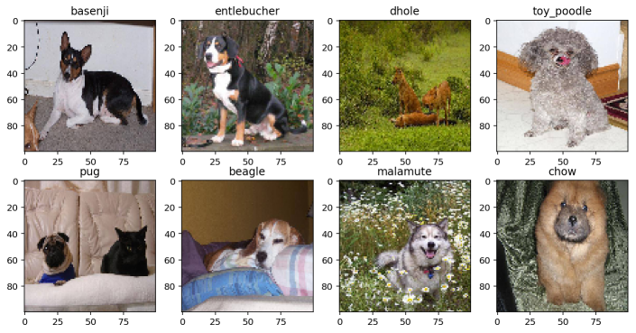
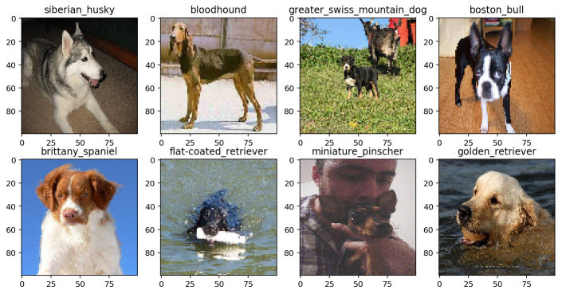
Results

Slide 8
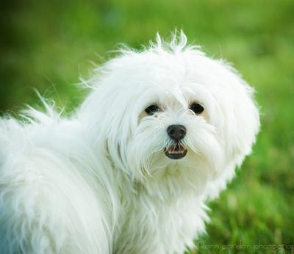
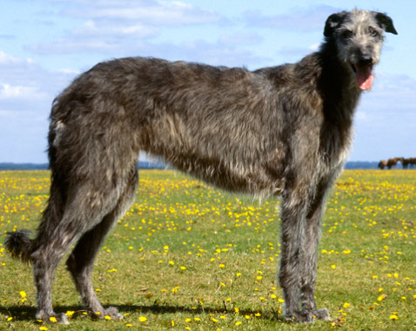
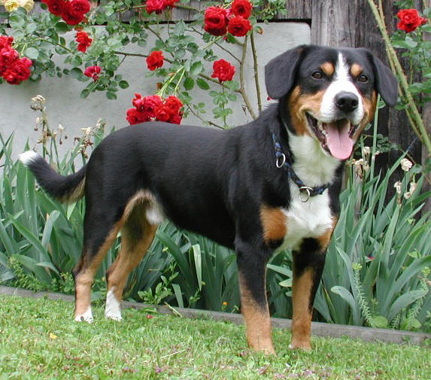
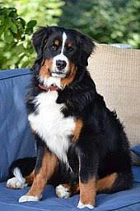
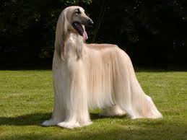
Result
Most repeated breeds:
Maltese dog Scottish deerhound Entlebucher Bernese mountain dog Afghan hound
New dataset contains 588 sample.(too small)

Slide 9
Result
Iteration: | 50 | 100 | 150 | 200 | 250 | 300 | 350 | 400 | 450 | 500
Training Accuracy: | 28.00% | 48.00% | 32.00% | 60.00% | 68.00% | 72.00% | 68.00% | 76.00% | 72.00% | 84.00%
Test Accuracy: | 30.50% | 29.70% | 36.40% | 36.40% | 36.40% | 38.10% | 44.90% | 44.90% | 43.20% | 44.90%
Iteration: | 550 | 600 | 650 | 700 | 750 | 800 | 850 | 900 | 950 | 1000
Training Accuracy: | 80.00% | 88.00% | 96.00% | 92.00% | 84.00% | 92.00% | 96.00% | 100.00% | 100.00% | 100.00%
Test Accuracy: | 44.10% | 41.50% | 47.50% | 44.90% | 47.50% | 49.20% | 47.50% | 43.20% | 47.50% | 46.60%

Slide 10
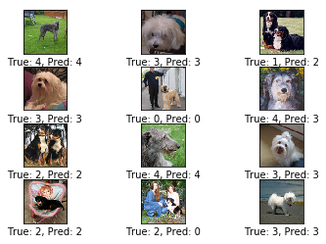
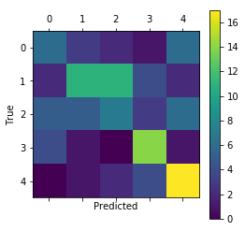
Results

Slide 11
Conclusion & Discussion
Base on the output table and the plot.
The model tends to be over-fitted. The test accuracy only up to 47%.

Slide 12
Problems
Two main questions:
sample size is too small.
588 is a small sample size in machine learning. The comment CNN example : determine handwriting has at least ten thousand images.
Images are bad.
There are not only dog in the image but also has human or other types of dog or cat.

Slide 13
Further Analysis
Based on limit sample size.
Mirror image
Generative adversarial network(GAN): a machine learning technique that can generate photographs that look similar to real photographs.(even though human can tell it is not a real photograph)
Try new technique called Keras(Designed to enable fast experimentation with deep neural networks)
Based on bad images
Crop out only dog image(some program could do that but don't know how could it work out in python)

Slide 14
Thank you!
Any questions?

